Slide 1
LIFE/work balance
We have started a #LIFEworkbalance campaign and we need your help to complete our LIFE/work balance survey.
We hope to publish the results soon, so please give 15 minutes of your time to help us get a true picture of school life.
Want to be a part of this campaign? Take the survey on our website and share it with your colleagues!
© Classroom Secrets Limited 2020

Slide 2
Year 3 – Spring Block 2 – Money – Converting Pounds and Pence
About This Resource:
This PowerPoint has been designed to support your teaching of this small step. It includes a starter activity and an example of each question from the Varied Fluency and Reasoning and Problem Solving resources also provided in this pack. You can choose to work through all examples provided or a selection of them depending on the needs of your class.
National Curriculum Objectives:
Mathematics Year 3 (3M9a) Add and subtract amounts of money to give change, using both £ and p in practical contexts
More Year 3 Money resources.
Did you like this resource? Don’t forget to review it on our website.
© Classroom Secrets Limited 2019

Slide 3
Year 3 – Spring Block 2 – Money
Step 2: Converting Pounds and Pence
© Classroom Secrets Limited 2019

Slide 4
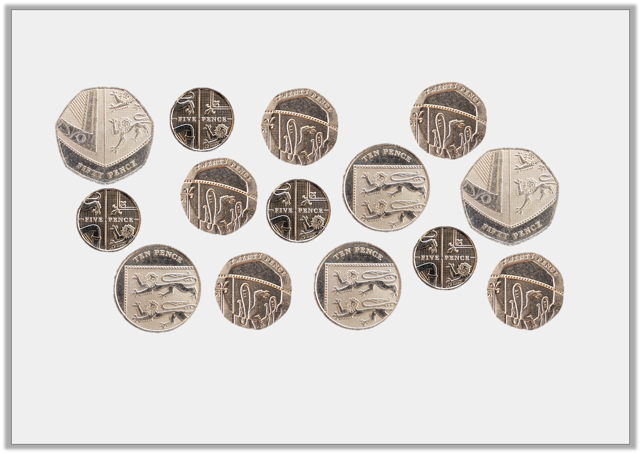
Introduction
Find 4 different ways to make £1.
© Classroom Secrets Limited 2019

Slide 5
Introduction
Find 4 different ways to make £1.
Various answers, for example:
50p + 50p = £1; 20p + 20p + 20p + 20p + 20p = £1;
50p + 20p + 10p + 10p + 10p = £1; 50p + 10p + 10p + 10p + 5p + 5p + 5p + 5p = £1.
© Classroom Secrets Limited 2019

Slide 6
Varied Fluency 1
Complete the amounts to make them equal.
A. | 418p | = | ________ and ________
B. | __________ p | = | £5 and 92p
C. | £7 and 26p | = | __________ p
© Classroom Secrets Limited 2019

Slide 7
Varied Fluency 1
Complete the amounts to make them equal.
A. | 418p | = | £4 and 18p
B. | 592p | = | £5 and 92p
C. | £7 and 26p | = | 726p
© Classroom Secrets Limited 2019

Slide 8
Varied Fluency 2
Circle the amount that will complete the statement.
823p
£7 and 9p
£7 and 81p | <
© Classroom Secrets Limited 2019

Slide 9
Varied Fluency 2
Circle the amount that will complete the statement.
823p
£7 and 9p
£7 and 81p | < | 823p
© Classroom Secrets Limited 2019

Slide 10
Varied Fluency 3
Put these amounts in order from the smallest to the largest.
A. | £4 and 46p
B. | 391p
© Classroom Secrets Limited 2019

Slide 11
Varied Fluency 3
Put these amounts in order from the smallest to the largest.
B, C, A
A. | £4 and 46p
B. | 391p
© Classroom Secrets Limited 2019

Slide 12
Varied Fluency 4
Complete the conversion table.
Pounds and Pence | Pence
£2 and 56p | _______ p
________ and ________ | 763p
£5 and 10p | _______ p
________ and ________ | 484p
© Classroom Secrets Limited 2019

Slide 13
Varied Fluency 4
Complete the conversion table.
Pounds and Pence | Pence
£2 and 56p | 256p
£7 and 63p | 763p
£5 and 10p | 510p
£4 and 84p | 484p
© Classroom Secrets Limited 2019

Slide 14
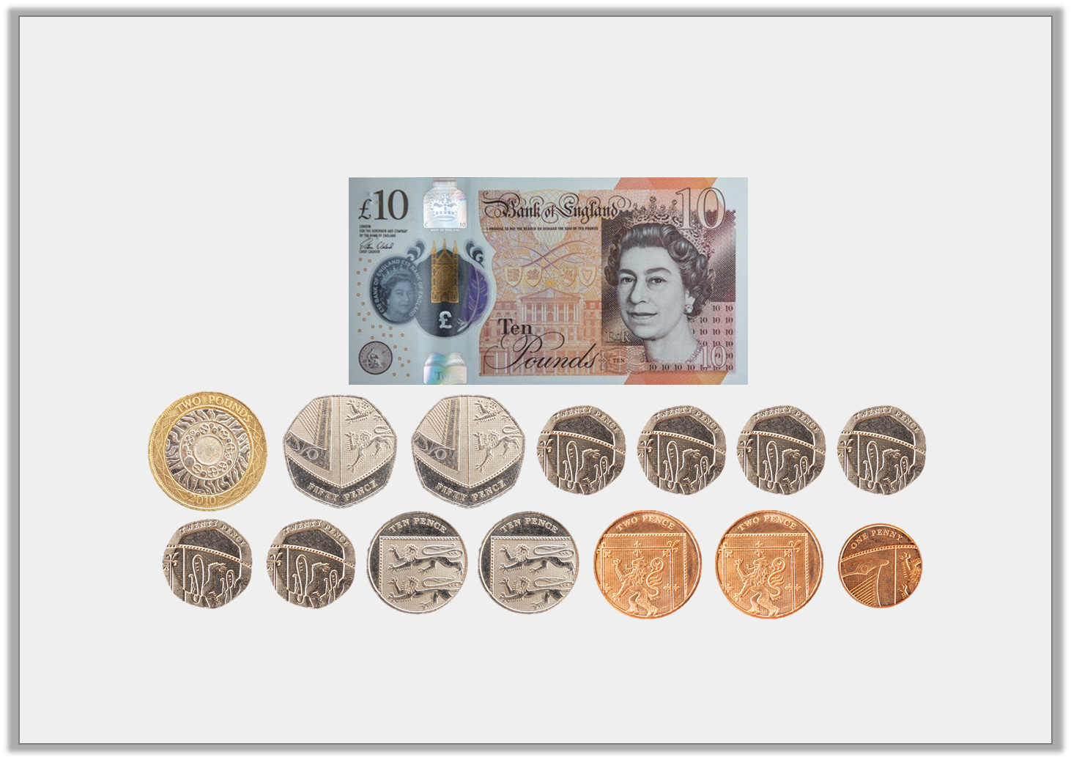
Reasoning 1
Fay has these coins in her pocket. Does she have enough money to buy a watch that costs £14 and 63p? Convince me.
© Classroom Secrets Limited 2019

Slide 15
Reasoning 1
Fay has these coins in her pocket. Does she have enough money to buy a watch that costs £14 and 63p? Convince me.
Fay has £10 and 445p…
© Classroom Secrets Limited 2019

Slide 16
Reasoning 1
Fay has these coins in her pocket. Does she have enough money to buy a watch that costs £14 and 63p? Convince me.
Fay has £10 and 445p = £14 and 45p. £14 and 45p is less than £14 and 63p so she doesn’t have enough money.
© Classroom Secrets Limited 2019

Slide 17
Reasoning 2
Theresa and Hardin are converting 407p into pounds and pence.
They say,
Who is correct? Explain why.
I think 407p =
£40 and 7p.
Theresa
I think 407p =
£4 and 7p.
Hardin
© Classroom Secrets Limited 2019

Slide 18
Reasoning 2
Theresa and Hardin are converting 407p into pounds and pence.
They say,
Who is correct? Explain why.
Hardin is correct because…
I think 407p =
£40 and 7p.
Theresa
I think 407p =
£4 and 7p.
Hardin
© Classroom Secrets Limited 2019

Slide 19
Reasoning 2
Theresa and Hardin are converting 407p into pounds and pence.
They say,
Who is correct? Explain why.
Hardin is correct because he has recognised that 400p = £4 so 407p = £4 and 7p.
I think 407p =
£40 and 7p.
Theresa
I think 407p =
£4 and 7p.
Hardin
© Classroom Secrets Limited 2019

Slide 20
Problem Solving 1
Azra has 4 different coins in her purse; a £1 coin, a 50p and 2 other coins.
How much money could be in the purse? Write 3 possible answers.
Written in pounds and pence | Written in pence
© Classroom Secrets Limited 2019

Slide 21
Problem Solving 1
Azra has 4 different coins in her purse; a £1 coin, a 50p and 2 other coins.
How much money could be in the purse? Write 3 possible answers.
Various answers, for example: See table.
Written in pounds and pence | Written in pence
£3 and 51p | 351p
£1 and 72p | 172p
£1 and 65p | 165p
© Classroom Secrets Limited 2019

